Slide 1
Operating Systems
CSE - 3103

Slide 2
Operating Systems & Systems Programming
Memory Management
Address Space
Just as the process concept creates a kind of abstract CPU to run programs, the address space creates a kind of abstract memory for programs to live in.
An address space is the set of addresses that a process can use to address memory. Each process has its own address space, independent of those belonging to other processes
(except in some special circumstances where processes want to share their address spaces).

Slide 3
Operating Systems & Systems Programming
Memory Management
Virtual Memory
Virtual memory is a memory management capability of an OS that uses hardware and software to allow a computer to compensate for physical memory shortages by temporarily transferring data from random access memory (RAM) to disk storage.
Computers have a finite amount of RAM so memory can run out, especially when multiple program run at the same time. A system using virtual memory can load larger programs or multiple programs running at the same time, allowing each one to operate as if it has infinite memory and without having to purchase more RAM.

Slide 4
Operating Systems & Systems Programming
Memory Management
Virtual Memory
Simulating more random access memory (RAM) than actually exists, allowing the computer to run larger programs and multiple programs concurrently. A common function in most every OS and hardware platform, virtual memory uses storage (hard drive or solid state drive) to temporarily hold what was in RAM.

Slide 5
Operating Systems & Systems Programming
Memory Management
Virtual Memory
Virtual memory is a valuable concept in computer architecture that allows you to run large, sophisticated programs on a computer even if it has a relatively small amount of RAM

Slide 6
Operating Systems & Systems Programming
Memory Management
Virtual Memory
Virtual memory is a feature of an operating system that enables a computer to be able to compensate shortages of physical memory by transferring data from random access memory to disk storage.

Slide 7
Operating Systems & Systems Programming
Memory Management
Virtual Memory
Virtual memory is implemented using
Paging
Segmentation

Slide 8
Operating Systems & Systems Programming
Memory Management
Paging
Paging is a memory management scheme by which a computer stores and retrieves data from secondary storage for use in main memory. In this scheme, the operating system retrieves data from secondary storage in same-size block called pages. The physical region of memory containing a single page is called a frame.

Slide 9
Physical Address Space
Physical address space in a system can be defined as the size of the main memory. It is really important to compare the process size with the physical address space. The process size must be less than the physical address space.

Slide 10
Logical Address Space
Logical address space can be defined as the size of the process. The size of the process should be less enough so that it can reside in the main memory.

Slide 11
Operating Systems & Systems Programming
Memory Management
Paging
Logical Address or Virtual Address : An address generated by the CPU
Logical Address Space or Virtual Address Space : The set of all logical addresses generated by a program
Physical Address : An address actually available on memory unit
Physical Address Space : The set of all physical addresses corresponding to the logical addresses

Slide 12
Operating Systems & Systems Programming
Memory Management
Paging
The virtual address space consists of fixed-size units called pages. The corresponding units in the physical memory are called page frames.

Slide 13
Operating Systems & Systems Programming
Memory Management
Paging
The Physical Address Space is conceptually divided into a number of fixed-size blocks, called frames.
The Logical address Space is also splitted into fixed-size blocks, called pages.
Page Size = Frame Size

Slide 14
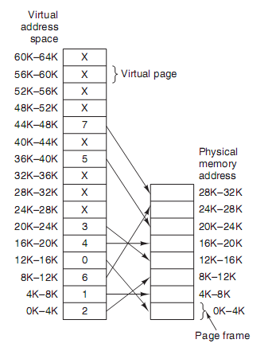
Operating Systems & Systems Programming
Memory Management
Paging

Slide 15
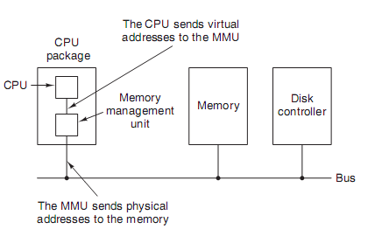
Operating Systems & Systems Programming
Memory Management
Paging
When virtual memory is used, the virtual addresses do not go directly to the memory bus. Instead, they go to an MMU (Memory Management Unit) that maps the virtual addresses onto the physical memory addresses, as illustrated in Fig.

Slide 16
Operating Systems & Systems Programming
Memory Management
Paging
A page table is the data structure used by a virtual memory system in a computer operating system to store the mapping between virtual addresses and physical addresses.
The page number is used as an index into the page table, yielding the number of the page frame corresponding to that virtual page.

Slide 17
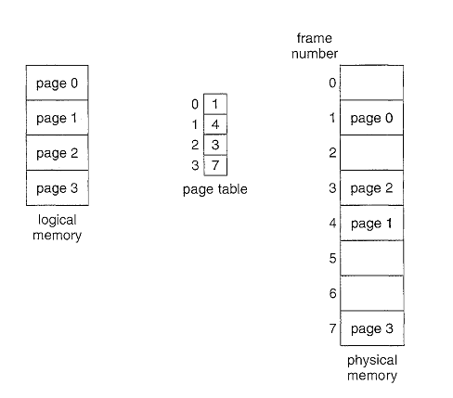
Operating Systems & Systems Programming
Memory Management
Paging
Paging model of logical and physical memory.

Slide 18
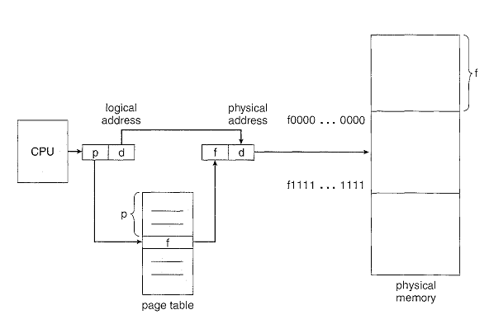
Operating Systems & Systems Programming
Memory Management
Paging
Paging hardware.

Slide 19
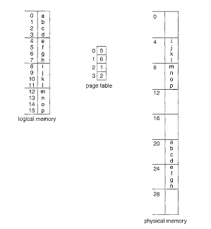
Operating Systems & Systems Programming
Memory Management
Paging
Paging example for a 32-byte memory with 4-byte pages. .

Slide 20
Operating Systems & Systems Programming
Memory Management
Paging
Using a page size of 4 bytes and a physical memory of 32 bytes (8 pages), we show how the user's view of memory can be mapped into physical memory.
Logical address 0 is page 0, offset 0. Indexing into the page table, we find that page 0 is in frame 5. Thus, logical address 0 maps to physical address 20 [= (5 x 4) + 0].
Logical address 3 (page 0, offset 3) maps to physical address 23 [ = (5 x 4) + 3].
Logical address 4 is page 1, offset 0; according to the page table, page 1 is mapped to frame 6. Thus, logical address 4 maps to physical address 24 [ = ( 6 x 4) + O].
Logical address 13 maps to physical address 9.

Slide 21
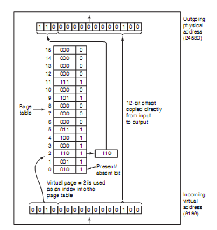
Operating Systems & Systems Programming
Memory Management
Paging
The internal operation of the MMU with 16 4-KB pages.

Slide 22
Operating Systems & Systems Programming
Memory Management
Segmentation
Paging is one-dimensional because the virtual addresses go from 0 to some maximum address, one address after another. For many problems, having two or more separate virtual address spaces may be much better than having only one. For example, a compiler has many tables that are built up as compilation proceeds the purpose of the segment in the program.

Slide 23
Operating Systems & Systems Programming
Memory Management
Segmentation
Consider how you think of a program when you are writing it. You think of it as a main program with a set of methods, procedures, or functions. It may also include various data structures: objects, arrays, stacks, variables, and so on. Each of these modules or data elements is referred to by name. You talk about "the stack," "the math library," "the n1ain program," without caring what addresses in memory these elements occupy.

Slide 24
Operating Systems & Systems Programming
Memory Management
Segmentation
You are not concerned with whether the stack is stored before or after the Sqrt () function. Each of these segments is of variable length; the length is intrinsically defined by the purpose of the segment in the program. Elements within a segment are identified by their offset from the begim1.ing of the segment: the first statement of the program, the seventh stack frame entry in the stack, the fifth instruction of the Sqrt (), and so on.

Slide 25
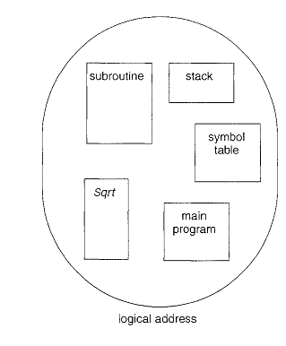
Operating Systems & Systems Programming
Memory Management
Segmentation
.
User's view of a program.

Slide 26
Operating Systems & Systems Programming
Memory Management
Segmentation
Segmentation is a memory-management scheme that supports this user view of memory
Logical address space is a collection of segments. Each segment has a name and a length. The addresses specify both the segment name and the offset within the segment. User specifies each address by two quantities: a segment name and an offset. For simplicity of implementation, segments are numbered and are referred to by a segment number, rather than by a segment name. Thus, a logical address consists of a two tuple:
<segment-number, offset>.

Slide 27
Operating Systems & Systems Programming
Memory Management
Segmentation
A Memory Management technique in which memory is divided into variable sized chunks which can be allocated to processes. Each chunk is called a Segment. A table stores the information about all such segments and is called Segment Table.

Slide 28
Operating Systems & Systems Programming
Memory Management
Segmentation
Segment Table – It maps two dimensional Logical address into one dimensional Physical address. It’s each table entry has:
Base Address: It contains the starting physical address where the segments reside in memory.
Limit: It specifies the length of the segment.

Slide 29
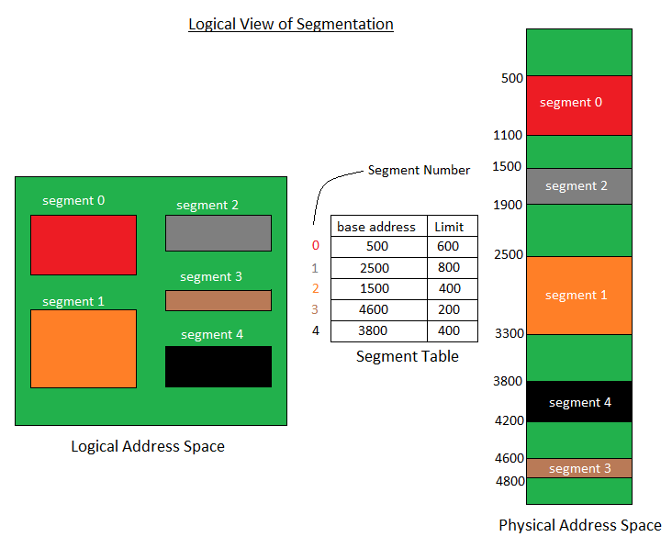
Operating Systems & Systems Programming
Memory Management
Segmentation

Slide 30
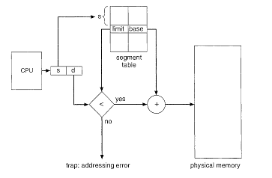
Operating Systems & Systems Programming
Memory Management
Segmentation
Segmentation hardware.

Slide 31
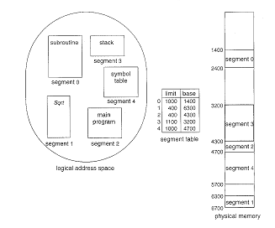
Operating Systems & Systems Programming
Memory Management
Segmentation
Example of segmentation.

